Slide 1
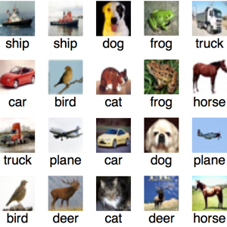
Image classification using cnn
- Viraj Savaliya
Application - Image classification to identify and differentiate objects
Practical uses in daily life in web search, medical diagnosis, security, etc.
Problems – A. Exploiting small and ultra large-scale datasets
B. Many categories
C. Scene understanding, grasp details
D. Network density, Time increases
E. Computational complexity, more time, better resource required
Architectures – AlexNet, VGGNet, GoogleNet, ResNet
Evolved with more layers added, change in size of filters, optimization techniques, etc

Slide 2
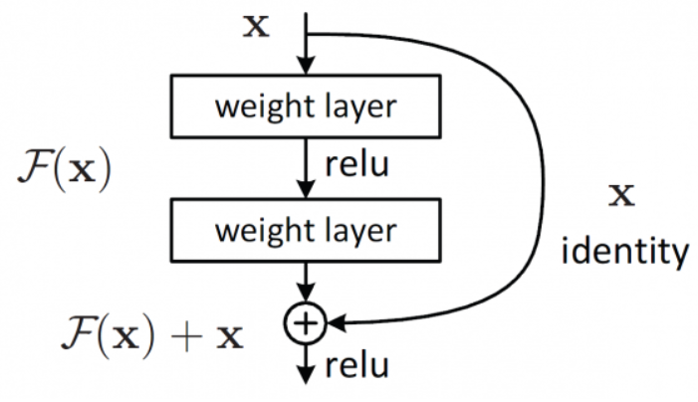
ResNet – Residual Networks (2015)
Deep Neural Network – Many layers
Stacked layers - Extract Multi-level features
Solves Degradation Problem –Accuracy saturation and degrading rapidly
Uses Batch Normalization – Each layer learn independently, Speedup
Optimizes the Network using Identity skip connections – Hops few stacked layers to fir desired underlying mapping
Similar to Long Short-Term Memory
Deep Residual Learning Framework

Slide 3
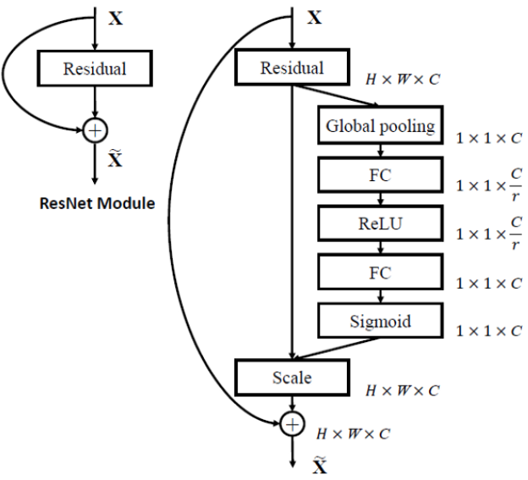
SENets – Squeeze and Excitation Networks (2017)
State-of-the-art
SE –Blocks
Extension to other networks (SE-ResNet)
Adaptively re-calibrates channel-wise features
Models interdependencies between channels
Flexible Architecture
Improves accuracy by x2
Additional computational cost < 1%

Slide 4
requirements
Online Source Code ^{[1], [2], [3]}
Datasets – Cifar10 (60k images, 10 classes)
Environments Used:
Google Colab
TensorFlow
Keras
Python
Time required: 18 hours approx. (250 epochs)

Slide 5
Results
Cifar10 dataset used
Original Results for SE-ResNet-110^{[4]} – 5.21% error
Obtained Results for SE-ResNeXt (approx. 37 layers) - 3% error approx.
ResNeXt better due to Cardinality and split-transform-merge paradigm used, network goes deep and wide but each independent path follows same topology
REFERENCES
https://github.com/taki0112/SENet-Tensorflow
https://github.com/yungshun317/keras-cifar-10-senet
https://github.com/RayXie29/SENet_Keras
J. Hu, L. Shen, and G. Sun, “Squeeze-and-excitation networks,” in 2018 IEEE/CVF Conference on Computer Vision and Pattern Recognition, 2018, pp. 7132–7141.

